Slide 1
An Introduction
Omidyar Network:

Slide 2
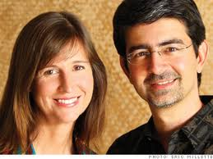
About Omidyar Network
BELIEF: Every individual has the power to make a difference
MISSION: Create opportunity for individuals to improve their lives, and the lives of their family, their community and society, with the objective of social impact at scale
VALUES: Respect, Impact, Collaboration, In Service, Humility
“How Can We Do This Most Effectively?”
Notes:
A. Omidyar Network exists to creative positive social impact in the world. We are motivated by the same attitudes and principles of the gospel, and share the same values and ends in an effort to serve the betterment of humankind. We are founded on the belief in the capacity of all individuals and their ability to good in the world. To us, access to opportunity is fundamentally a question of justice and values.
ON core belief: Every person has the power to make a difference
ON mission: Create opportunity for individuals to improve their lives, and the lives of their family, their community and society, with the objective of social impact at scale
ON approach: Strong focus on entrepreneurship and serving disadvantaged populations globally
ON values: Respect, impact, collaboration, in service, and humility
B. The main question we ask ourselves is, “How can we do this most effectively?” – we’ve been wrestling with this for ten years. Jeff Raikes (ex CEO of Gates Foundation) three-part breakdown:
Charity: Aids in the immediate alleviation of human suffering; especially crisis relief services > critically important, historically the role of the church and foundations (e.g., CRS)
Philanthropy: Strategic, often systems-based approaches that develop highly-effective, sustainable non-profits (e.g., Catholic education and healthcare delivery systems like Dignity Health (new name of Catholic Healthcare West) in the US); often profits reinvested into social impact
Business/Investing: Traditionally viewed as purely profit-seeking, but has fundamentally lifted many out of poverty (e.g., rise of middle class in China)
C. Based on Pierre’s experience at eBay and our reflections at Omidyar Network, we’ve engaged deeply in the latter two, embracing both strategic grant-giving and market-based philanthropy to best serve our values and maximize impact. Today we want to discuss a bit about our journey aligning profit and purpose.

Slide 3
Omidyar Family Foundation (OFF) to Omidyar Network (ON)
2004 to date
Hybrid structure for flexibility
Strategic grant-giving + market-based philanthropy
OMIDYAR FAMILY
FOUNDATION
2000
Traditional grant-giving
Constrained by limited model
Over a million jobs created
Power of the markets can help scale solutions that empower people and benefit society.
1998
Notes:
A. When eBay went public in 1998, Pierre found himself wealthy beyond what he ever expected. Almost immediately he wondered, “How can I deploy this capital to the betterment of mankind?” He started with a traditional grant-based, philanthropic approach and set up a foundation, but very quickly became frustrated with the limitations of this model.
B. Constraints experienced in his early experience with OFF; foundations not built to take advantage of power of business and markets.
eBay experience: more than a million jobs created, many of which went to underserved. Looked conversely at the nonprofit sector and saw how difficult it is to scale impact without sustainable revenue models. Intuition was that in some cases the power of the market could be tapped to really help scale solutions for the disadvantaged. Pierre asked, “How can business principles intentionally be applied to social good and serve more people?”
Philosophically something wrong with the idea that you should make money on the one hand and then "give back" on the other. This is particularly true when we think of the structure of charitable foundations, and the idea that foundations are investing billions of dollars just to maximize profit so they can give away a small percentage of it each year.... rather than thinking about their responsibility to use all of the resources at their disposal to create the most impact in the word.
C. Transition to Omidyar Network
Pierre decided not to be constrained by structure, and redesigned a hybrid entity to give flexibility to do whatever fits the bill. Investment professionals hired to treat grant and investment dollars equally and decide which vehicle to use based on what would create the most impact.

Slide 4
Omidyar Network at Scale
London
Redwood City
Washington, DC
Mumbai
Johannesburg
COMMITMENTS
Total amount committed since
inception:
688
For-profit investments
since inception:
314
Nonprofit grants since inception:
374
$
$
$
million
million
million
Notes:
In the last 10 years, we’ve committed $688 million, $314 million for-profit and $374 million nonprofit.
We have ~85 employees across five offices: Silicon Valley, Johannesburg, London, Mumbai, and Washington DC.

Slide 5
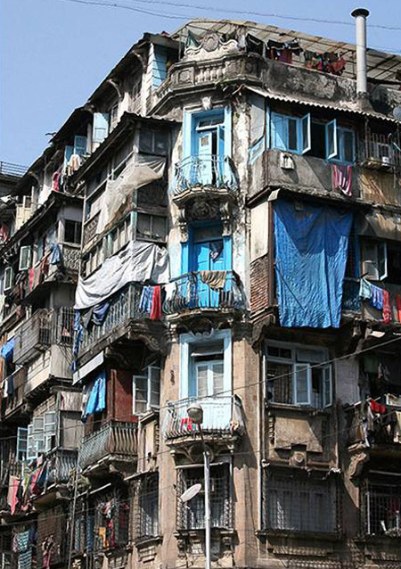
Flexible Capital: Nonprofit Grants
Provide Public Goods
Help disadvantaged Populations
Subsidize goods and services
Notes:
We see strategic grant-giving and market-based philanthropy as complimentary.
Grant-based philanthropy has had a tremendous positive impact on the world, in large part by overcoming fundamental market failures not addressed by government.
Grants are particularly useful in:
Providing public goods;
Helping disadvantaged populations;
And subsidizing the creation of goods and services that benefit society as well as the individual; that is, goods with large positive externalities.
Grants also help spur the creation of new markets where an unattractive risk/reward profile discourages investment and can help build infrastructure/create ecosystem.
Examples: BRAC > 135 million lives/year, $450m budget, 70-80% self-funded; NP and FP components; world’s largest NGO operating in some of world’s toughest locations

Slide 6
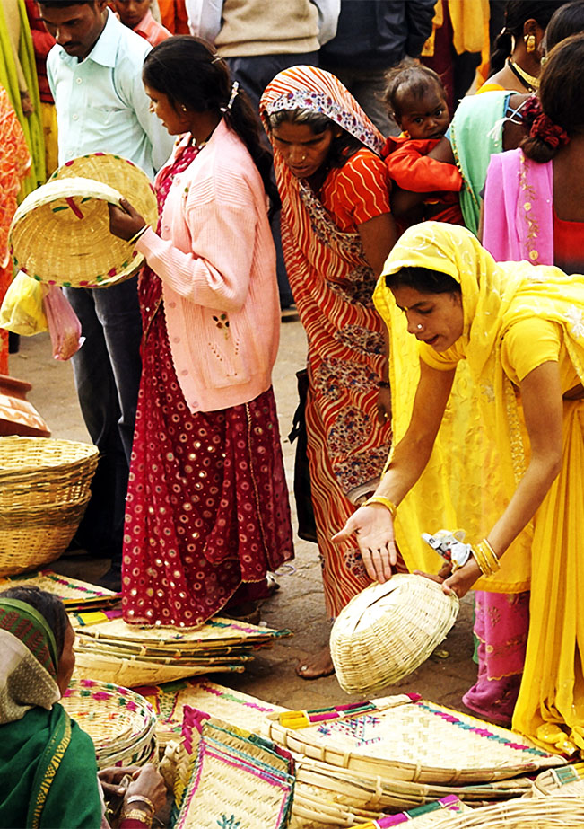
Flexible Capital: For-Profit Investments
Value
Self-Sustainability
Massive scale
Notes:
Our for-profit investments can generate positive social impact by leveraging the power of markets.
Not just because of the jobs a business creates, but also because of profit. As sustained profit represents a solution that works, a business model that has been de-risked and is self-sustaining, and a customer who values the solution.
Profit fuels scale. There are billions of people that need to be served. Sustainable models help organizations help themselves and become bigger and can touch more lives. Sustainable for-profit models also allow for reinvesting in the mission.
Example: d.Light > Amazing solar lantern company, serves over 40 countries. Started just six years ago, now shipping/selling over 500,000 units per month, providing over 34 million people with a safe, affordable and clean light source so children can do their homework and entrepreneurs can “burn the midnight oil.” Early stage risk capital opened up a new model with outsized impact that could scale through revenue.
NOTE: BRIDGE ACADEMIES EXAMPLE BELOW AS ALTERNATIVE
Bridge Academies as secondary FP example
ON investee, Bridge International Academies is a highly scalable school-in-a-box model in Kenya offering high-quality education at an affordable price of $5/month (on average).
200+ academies in Kenya, more than 95,000 pupils enrolled.
Outperform government schools as the largest chain on the African continent, attracting capital from Silicon Valley venture firms like Khosla and NEA.

Slide 7
The Relationship Between Profit & Impact
Key questions to consider:
How do you ensure mission drives your work, and not short-term profit?
What are the tensions between social impact and financial return?
What types of investments will have the most positive impact on people?
Notes:
A. We recognize there is an inherent tension between profit and impact—we wrestle with those questions every day. How do we ensure that mission drives our work, and not short-term profit?
For those who approach impact investing with the core intention of maximizing impact, there is often confusion about whether there is a tradeoff between social impact and financial return.
Some think only those businesses with healthy revenues will be able to scale and have the most impact; others are conversely worried that these businesses may not be really going after the hardest social problems or may be profiting off the poor.
B. We feel strongly it's important to avoid ideology here and instead look pragmatically on a case-by-case basis by asking the question - what type of investment will maximize impact? In general, we find there are often win-win situations where there is a direct correlation between impact and healthy revenues - (revert to examples in slide before).
C. At ON we've developed a model that allows us to invest in whatever form would best guarantee impact in any given instance; but we are still in exploration mode and learning a lot along the way.
Change.org - equity but with special provisions and alternative to traditional exit
iMerit - hybrid investment - part grant, part investment

Slide 8
Q & A
Notes:
Thank you and questions

