Slide 1
CRS
Agricultural Livelihoods
Towards Impact Investment
Rome, 17th June, 2014
Shaun Ferris
Catholic Relief Services

Slide 2
CRS Agricultural Livelihoods 2013
328 projects in 44 countries
$152 m invested in smallholder agriculture
5 million farm family clients
Over 100 in-country implementing partners

Slide 3
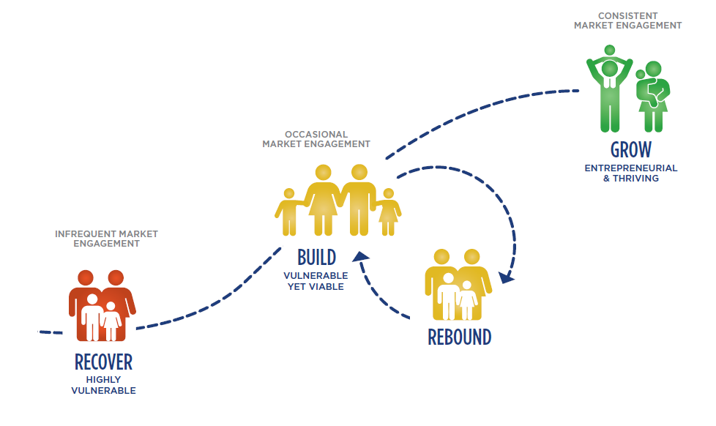
Supporting Vulnerable Communities
Pathway to Prosperity
5%
Pathway to Prosperity
25%
65%
Notes:
Building capacity
Understanding our client base
Measuring spatial patterns
Co-investing in change
What works for who
Tailoring implementation based on results
Measuring impact of our investments

Slide 4
Market Pull
Pathway to Prosperity
GROW
Consistent market sales
SERVICES
Resilient and empowered
Vulnerable but viable
BUILD
Increasing HH resilience
SKILLS
Occasional market sales
Increasing market performance
Market Push
REBOUND
RESILIENCE
RECOVER
Highly vulnerable
ASSETS
Infrequent market sales
Notes:
As farm households move along the pathway they gradually strengthen their capacity to cope with stress and build their resistance to potential catastrophic events that may occur in the future

Slide 5
Building Resilient Pathways to Prosperity
shock
Consistent
market sales
Private
capital
Resilient and empowered
Increasing HH resilience
Occasional market sales
The community
Resilience
Programming
Disaster
Risk Reduction
Vulnerable but Viable
Blended Capital funding
Increasing market performance
3.
1.
Infrequent market sales
2.
Transition
Grant Funding
Emergency
Funds
Highly vulnerable
Emergency
Grant Funds
$$$$$$$$$$
$$$$$$$$$$
$$$$$$
Notes:
As farm households move along the pathway they gradually strengthen their capacity to cope with stress and build their resistance to potential catastrophic events that may occur in the future

Slide 6
RECOVER
Pathway to Prosperity
GROW
Consistent market sales
Entrepreneurial
& thriving
Vulnerable but Viable
BUILD
Increasing HH resilience
Occasional market sales
Increasing market performance
REBOUND
RECOVER
Highly vulnerable
Infrequent market sales

Slide 7
Scaled of results - Cassava seeds delivery
$20M to reach 1.2 million beneficiaries

Slide 8
Working at Scale across Scale levels
Clients
1M +
100,000’s
10,000’s
1,000’s
Early Warning/ DRR/ CCA
Health
Natural Resource Management
National
Districts
Community
Livelihoods
Value chains
Households
Connectedness
Notes:
In the past we focused our attention on Households, them communities.
Through technology, we can now work across scales
By identifying key partners at each level we can find ways to support more effective scaling pathways. So its important that we show how connectedness of our interventions and the key actors works across levels of scale.
Measuring our performance in resilience remains a new challenge, but we do need to be able not only improved access to services, but also measure changes in the connectedness of different scale options related to sectoral performance.

Slide 9
BUILD
Pathway to Prosperity
GROW
Consistent market sales
Entrepreneurial
& thriving
Vulnerable but Viable
BUILD
Increasing HH resilience
Occasional market sales
Increasing market performance
REBOUND
RECOVER
Highly vulnerable
Infrequent market sales

Slide 10
Metrics - Technology DATA Partners
Monitoring Evaluation and Learning
Analytics / Data Sharing
Digital forms
Portfolio Management
Data Warehouse
Open Data
Farmer Tools
Mapping
Biz planner
e-learning
Notes:
Requirements
Spiral Development
Integration

Slide 11
Digital systems to measure across projects
Data standards
Notes:
This slide shows our Farmbook information suite.
This approach allows us to
Provide field agents with tools to conduct baseline and follow up surveys.
Train field agents with distance learning courses, in their local languages, and monitor their progress.
Register Farmer groups
Conduct profitability analysis and prepare Business plans
Map and track field agent interactions with farmers
Monitor crop and income performance.

Slide 12
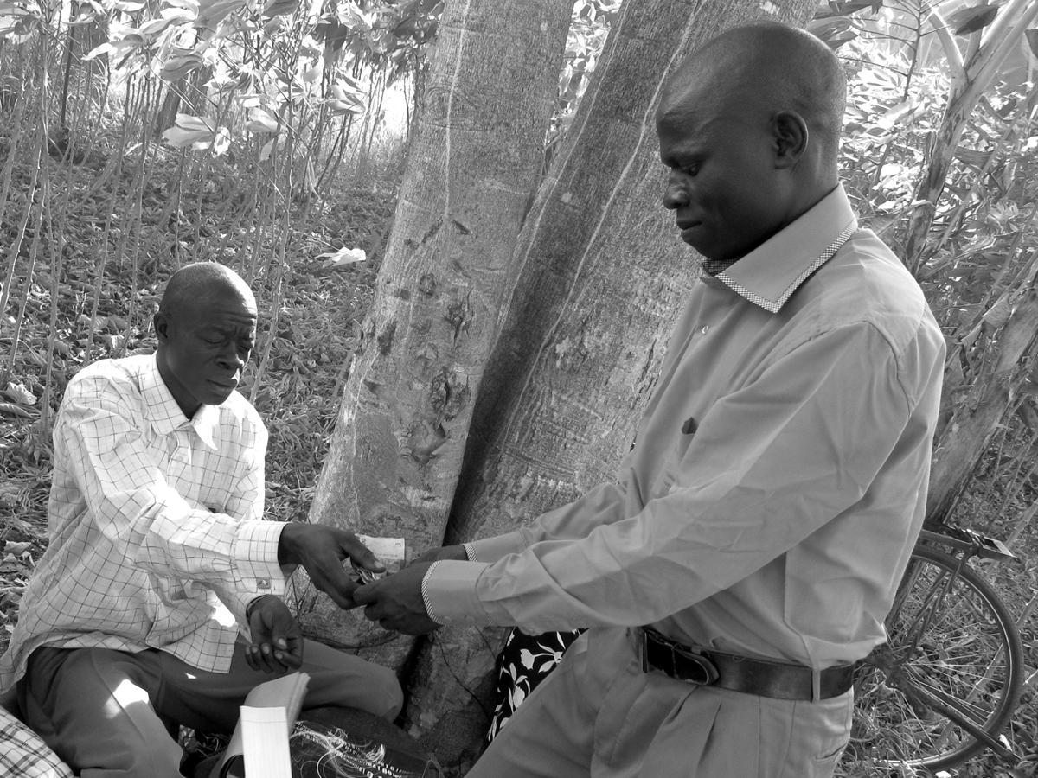
Private sector service provision
The PSP Model
http://www.youtube.com/watch?v=RsDTpA9eN1o

Slide 13
Progression of free based Service Products
Productive
Consumers
Skills acquisition
Loans
Savings and Loans
Financial
education
Marketing
basics
Business
planning
Lease
Insurance

Slide 14
Unexpected trends….
from free to fees

Slide 15
GROW
Pathway to Prosperity
GROW
Consistent market sales
Entrepreneurial
& thriving
Vulnerable but Viable
BUILD
Increasing HH resilience
Occasional market sales
Increasing market performance
REBOUND
RECOVER
Highly vulnerable
Infrequent market sales

Slide 16
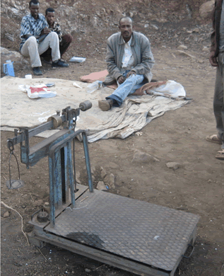
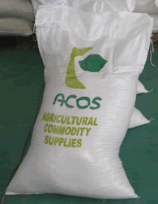
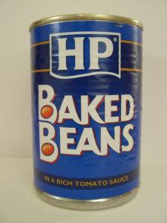
Business Model for Bean Exports Ethiopia
Service providers
Technical / trade facilitation
Technical / trade facilitation
inputs
technical assistance
financing
Traders
ACOS – Ethiopia
(exporter)
ACOS-Italy trader
Premier Foods
Farmers
Cooperative unions

Slide 17
Impact Investment issues Gains and Challenges
II brings the discipline of the marketplace
Offers new sources of capital
Shift beyond the project cycle
Scaled and sustainable intervention
Align goals between partners and sectors
Sustained scaling is a challenge
Charitable orgs struggle with revenue and profits
Need better metrics and data systems
Require donors to adapt contract /grant options
Will require new skills mix, new partnerships

